Slide 1


INFT 1012 Network Fundamentals
Week 13 – Topic Outline and Highlights

Slide 2
Outline
Network Design
Commands for verifying device configuration
Network Security

Slide 3
Readings
CCNAv7: Introduction to Networks course text & quizzes
Module 17 (can skip section Sections 17.6.3, 17.6.4 17.7.1)
Module 16
Available at: www.netacad.com

Slide 4
Design a small network – things to consider
Topology
Device selection
IP addressing
Redundancy
Traffic management
Applications and protocols
Future expansion

Slide 5
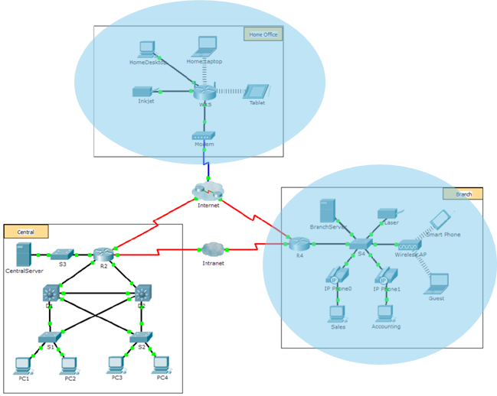
Small Network Topologies & Device Selection
Small networks have simple designs.
Each of the shaded network is an example of a small network
A small number of network devices needed.
Usually comprises 1 router, 1 or more switches, wireless access points and use PCs/devices.
Internet connection is achieved through a single WAN link (commonly either cable or DSL), or an Ethernet connection.
Most management tasks are related to maintaining and troubleshooting existing equipment and securing the network.
When implementing a small network, a key design consideration is the type of intermediate devices to use to support the network.
Factors to consider when choosing a device include cost, speed and types of ports/interfaces, expandability, OS features, Security, and services (QoS, NAT, DHCP etc.)

Slide 6
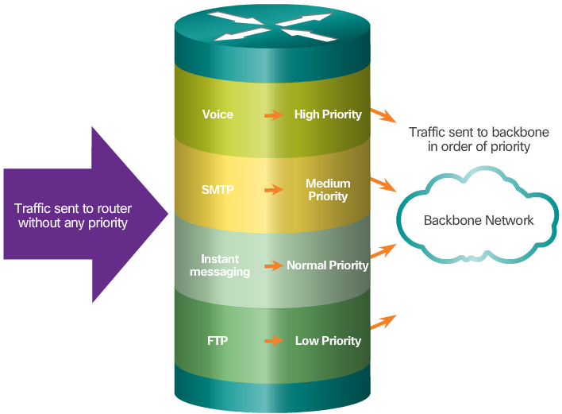
IP Addressing
Redundancy
A crucial component of a network design.
The address scheme must be planned, documented, and maintained.
Address documentation
can be very useful for troubleshooting
very important when controlling resource access
Redundancy increases reliability by eliminating single points of failure.
Network redundancy can be achieved by duplicating network equipment and links.
Small networks typically has a single exit point towards the Internet. If the router fails, the entire network loses connectivity to the Internet.
Advice: pay for a second service provider as backup.
Traffic Management
Traffic type and patterns should also be considered when designing a network.
A good network design categorizes traffic according to priority.
Notes:
Organise addresses based on device types, organizational units, or locations?
Static addresses or dynamic addresses?

Slide 7

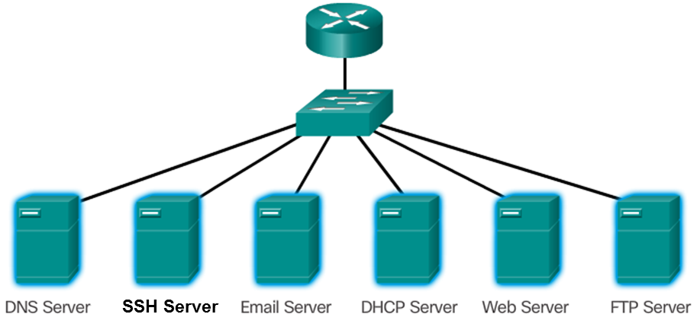
Applications and Supporting Protocols
Common applications:
What are the protocols supporting these services? – find out the answers in the readings.
Voice and video applications requires:
Network infrastructure supporting real-time applications
Existing switches and cabling support the traffic added by the applications?
Network devices are configured to ensure priority delivery?
VoIP (voice over IP) or IP telephony devices and applications
Protocol supporting real-time streaming applications
RTP (Real-time Transport Protocol) and RTCP (Real-time Transport Control Protocol)
Notes:
Many companies have established a policy of using secure versions of these protocols whenever possible. These protocols are HTTPS, SFTP, and SSH.

Slide 8
Small Network Growth
Elements required when making decision on scaling up a network:
Network documentation
Device inventory
Budget
Traffic analysis
Understand the type of traffic and the current traffic flow, and the traffic changing trends.
A protocol analyser, e.g. Wireshark will help identify the traffic and its source.
Protocol analysis helps with managing network traffic more efficiently, especially as the network grows.
it is important to capture traffic in high-utilization times and in different locations of the network.
Employee Network Utilization
A network administrator can create in-person IT “snapshots” of employee application utilization, e.g. OS and OS version, network and non-Network applications, CPU, Drive and RAM utilization
A shift in resource utilization may require an adjustment of network resource allocation accordingly.

Slide 9
Useful commands for verifying device configuration
The “show” commands on routers/switches
Commands used on hosts
Note: commands for connectivity verification, ping and tracert/traceroute were discussed in last week.

Slide 10
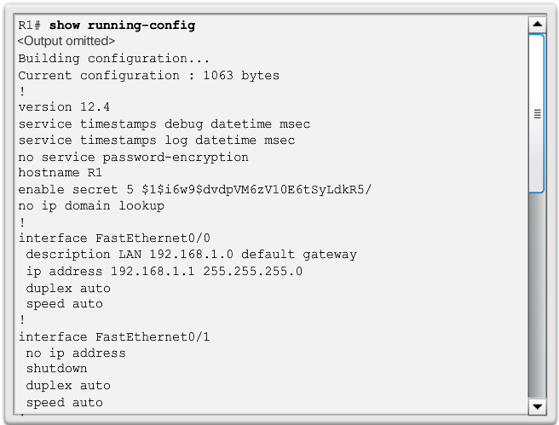
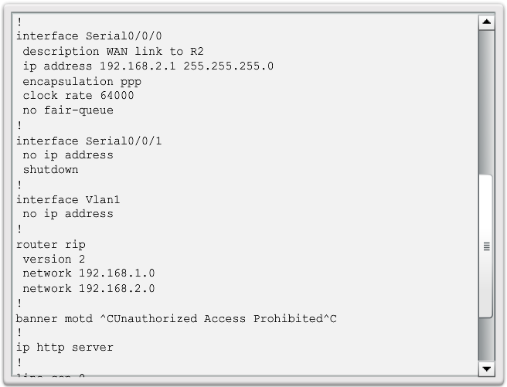
Common show Commands Revisited
The Cisco IOS CLI show commands are powerful troubleshoot tools.
The show commands display configuration files, checking the status of device interfaces and processes, and verifying the device operational status.
The status of nearly every process or function of the router can be displayed using a show command.
Some of the more popular show commands are:
show running-config
show interfaces
show arp
show ip route
show protocols
show version

Slide 11
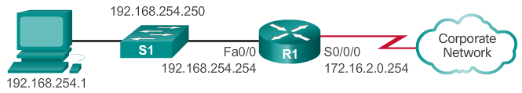
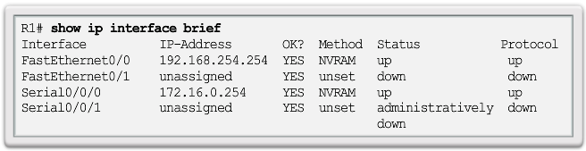
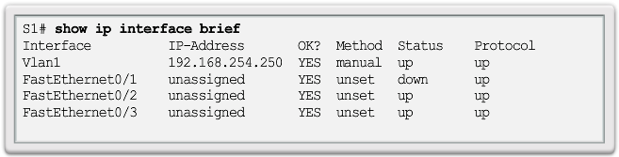
The show ip interface brief Command
The show ip interface brief command displays a summary of the key information for all the network interfaces on a router.
The show ip interface brief command can also be used to verify the status of the switch interfaces.

Slide 12
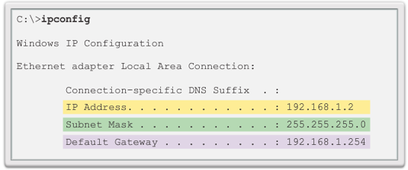
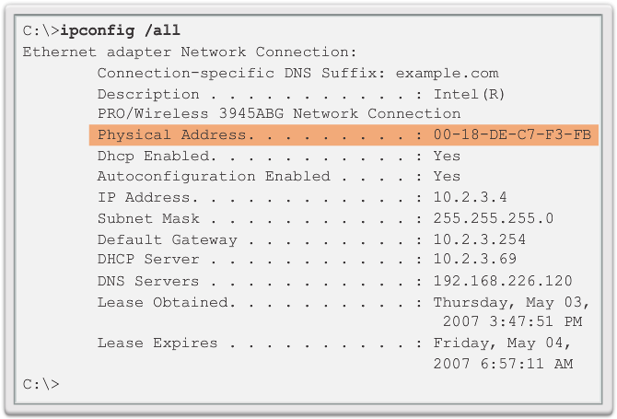
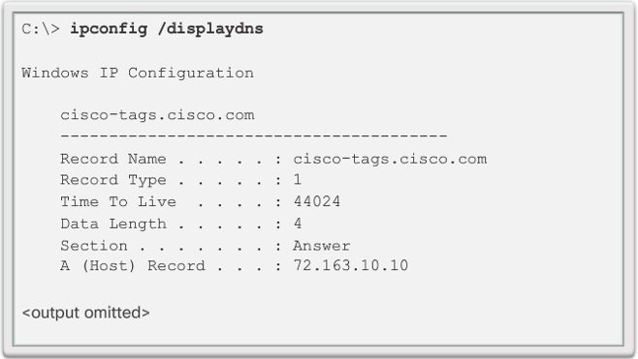
The ipconfig Command
The ipconfig command can be used to display IP information on a Windows-based computer.
The ipconfig command displays the host and its default gateway IP addresses.
Use the ipconfig /all command to view the host’s IP configuration in more detail, including its MAC address.
The ipconfig /displaydns command displays all of the cached DNS entries on a Windows-based computer system.
Note: on a linux or macOS host, the command is ifconfig

Slide 13
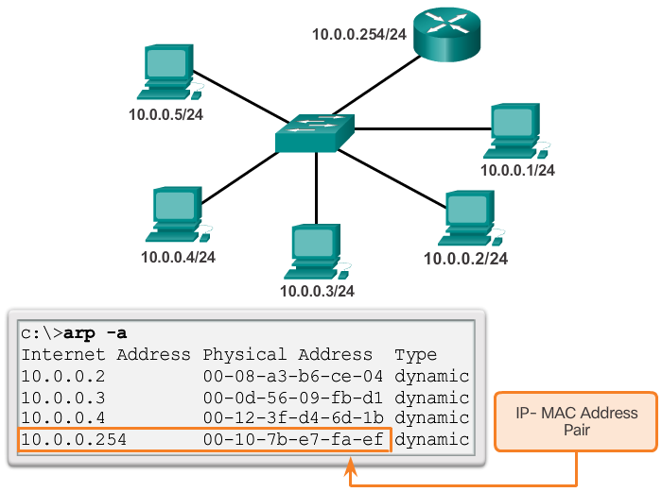
The arp Command
The arp –a command lists all devices currently in the ARP cache of the host.
It also includes the IPv4 address, physical address, and the type of addressing (static/dynamic), for each device.
The cache can be cleared by using the arp -d command.

Slide 14
Secure a small network – things to know
Types of threats
Types of vulnerabilities
Network attacks
Network attack mitigation
Device security

Slide 15
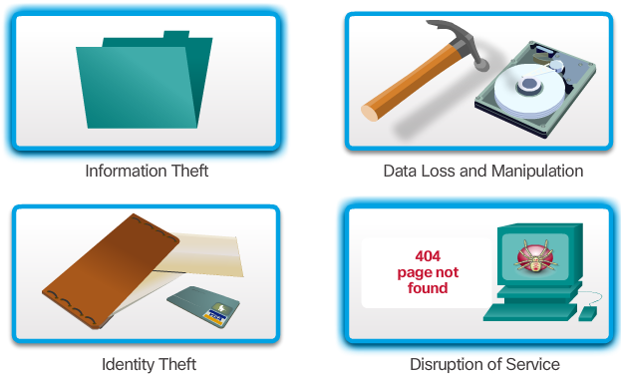
Types of Threats
Information Theft - Breaking into a computer to obtain confidential information
Data Loss and Manipulation - Breaking into a computer to destroy or alter data records
Identity Theft - personal information is stolen for the purpose of taking over someone's identity.
Disruption of Service: Preventing legitimate users from accessing services to which they should be entitled
Also need to pay attention to physical threats:
Hardware, e.g. physical damage to devices
Environmental, e.g. temperature or humidity extremes
Electrical, e.g. power loss, voltage spikes
Maintenance, e.g. poor handling of key electrical components, poor labeling, lack of critical spare parts
Notes:
intruders can gain access to a network through software vulnerabilities, hardware attacks or through guessing someone's username and password. Intruders who gain access by modifying software or exploiting software vulnerabilities are often called hackers.
After the hacker gains access to the network, four types of threats may arise,
Information Theft:
Breaking into a computer to obtain confidential information. Information can be used or sold for various purposes. Example: stealing an organization's proprietary information, such as research and development information.
Data Loss and Manipulation:
Breaking into a computer to destroy or alter data records. Examples of data loss: sending a virus that reformats a computer's hard drive. Examples of data manipulation: breaking into a records system to change information, such as the price of an item.
Identity Theft:
A form of information theft where personal information is stolen for the purpose of taking over someone's identity. Using this information, an individual can obtain legal documents, apply for credit, and make unauthorized online purchases. Identity theft is a growing problem costing billions of dollars per year.
Disruption of Service:
Preventing legitimate users from accessing services to which they should be entitled.Examples: Denial of Service (DoS) attacks on servers, network devices, or network communications links.

Slide 16
Types of Vulnerabilities
Vulnerability is the degree of weakness which is inherent in every network and device
There are three primary vulnerabilities:
Technological - Vulnerabilities in protocols, operating systems, and network equipment
Configuration - Vulnerabilities created by misconfigured devices, default configuration values, and easily guessed passwords
Security policy - Lack of security policy, software and hardware installation is not consistent with security policy, and no disaster or recovery plan
Typically, the devices under attack are the endpoints, such as servers and desktop computers.
Any of these three vulnerabilities can be exploited and used in attacks.

Slide 17
Malware Attacks
Reconnaissance Attacks
Malware (malicious software) or Malcode (malicious code) is software or code specifically designed to damage, disrupt, steal, or inflict “bad” or illegitimate action on data, hosts, or networks.
Types of malware:
Viruses
Worms
Trojan Horses
What is the difference between virus and worms? – Find the answer in the readings
The discovery and mapping of systems and services. Often not considered an attack on its own
Goal is to acquire enough information on the target system or network to facilitate the search for vulnerabilities
Common tools for reconnaissance attack rely mostly on free and public Internet services, such as DNS and Whois
Port-scanners and packet sniffers are also commonly used in reconnaissance attacks.
Notes:
Viruses
A computer virus is a type of malware that propagates by inserting a copy of itself into, and becoming part of, another program. It spreads from one computer to another, leaving infections as it travels. Viruses can range in severity from causing mildly annoying effects to damaging data or software and causing denial-of-service (DoS) conditions. Almost all viruses are attached to an executable file, which means the virus may exist on a system but will not be active or able to spread until a user runs or opens the malicious host file or program. When the host code is executed, the viral code is executed as well. Normally, the host program keeps functioning after it is infected by the virus. However, some viruses overwrite other programs with copies of themselves, which destroys the host program altogether. Viruses spread when the software or document they are attached to is transferred from one computer to another using the network, a disk, file sharing, or infected e-mail attachments.
Worms
Computer worms are similar to viruses in that they replicate functional copies of themselves and can cause the same type of damage. In contrast to viruses, which require the spreading of an infected host file, worms are standalone software and do not require a host program or human help to propagate. A worm does not need to attach to a program to infect a host and enter a computer through a vulnerability in the system. Worms take advantage of system features to travel through the network unaided.
Trojan Horses
A Trojan horse is another type of malware named after the wooden horse the Greeks used to infiltrate Troy. It is a harmful piece of software that looks legitimate. Users are typically tricked into loading and executing it on their systems. After it is activated, it can achieve any number of attacks on the host, from irritating the user (popping up windows or changing desktops) to damaging the host (deleting files, stealing data, or activating and spreading other malware, such as viruses). Trojan horses are also known to create back doors to give malicious users access to the system.
Unlike viruses and worms, Trojan horses do not reproduce by infecting other files, nor do they self-replicate. Trojan horses must spread through user interaction such as opening an e-mail attachment or downloading and running a file from the Internet.

Slide 18
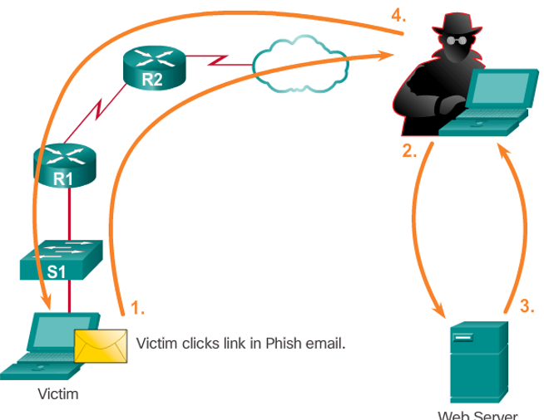
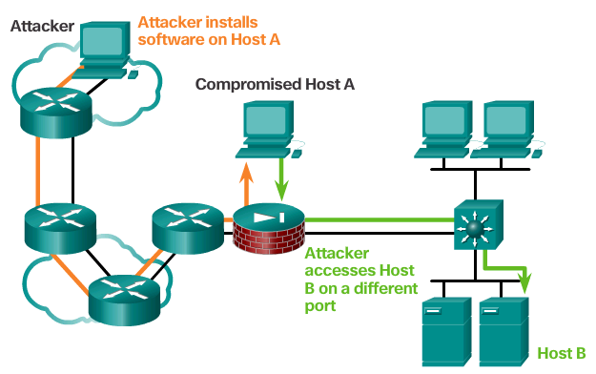
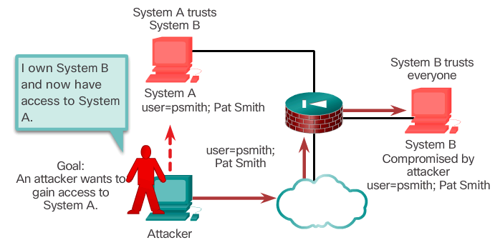
Access Attacks
Attacks against known vulnerabilities and services.
The goal is to gain access to information that they have no right to view.
Access attacks can be classified into four types:
Password Attacks
Trust Exploitation
Port Redirection
Man-in-the-Middle
How does each of these access attacks work? – Find the answer in the readings

Slide 19
Denial of Service (DoS) Attacks
DoS attacks prevent authorized people from using a service by consuming system resources.
Regarded as trivial and require little effort to execute, but are dangerous and difficult to eliminate.
To help prevent DoS attacks it is important to have the latest security updates.
Common DoS Attacks:
Ping of Death
SYN Flood
DDoS (Distributed DoS)
Smurf Attack
How does each of these DoS attacks work? – find the answer in the readings or online

Slide 20
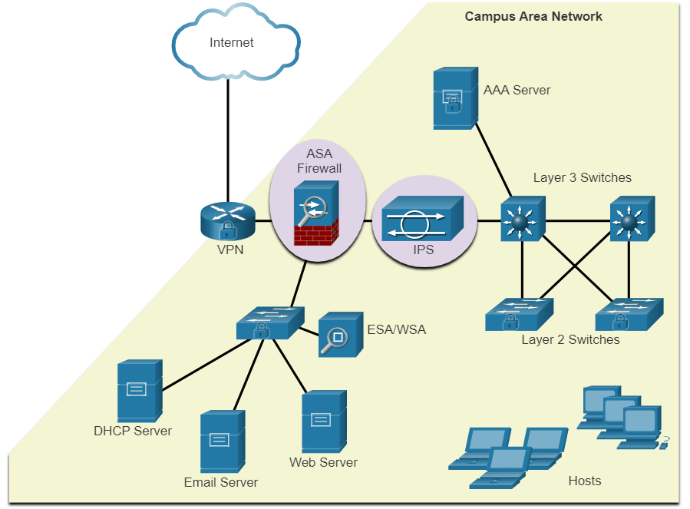
Network Attack Mitigation – a layered approach
To mitigate network attacks
Secure devices including routers, switches, servers, and hosts.
Take a defense-in-depth approach (also known as a layered approach) to security
Want to know what IPS, ESA/WSA, VPN, AAA server are? – check the readings

Slide 21
Network Attack Mitigation - Backup, Upgrade, Update, and Patch
Keeping up-to-date with the latest developments can lead to a more effective defense against network attacks.
As new malware is released, enterprises need to keep current with the latest versions of antivirus software.
To mitigate worm attacks, patches for all known vulnerabilities must be applied.
A central patch server can be a good solution for managing a large number of servers and systems.
Any patches that are not applied to a host are automatically downloaded from the patch server and installed without user intervention.

Slide 22
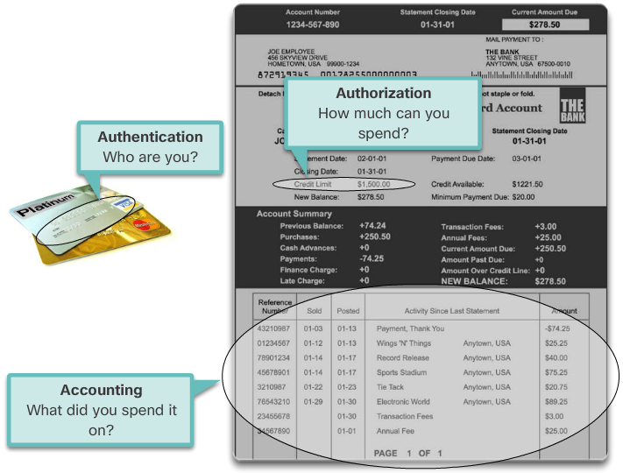
Authentication, Authorization, and Accounting
All network devices should be securely configured to provide only authorized individuals with access.
AAA services provide access control on a network device.
AAA is a way to control:
who is permitted to access a resource (authenticate)
what they can do while they are there (authorize)
what actions they perform while accessing the resource (accounting)
The AAA framework can be very helpful when mitigating network attacks.

Slide 23
Firewalls
A firewall controls the traffic and helps prevent unauthorized access
Two types of firewalls:
Network firewalls: residing between two or more networks
Host-based or personal firewalls: installed on end systems
Techniques used in firewalls for determining what is permitted or denied access to a network:
Packet filtering: based on IP or MAC addresses
Application filtering: specific application types based on port numbers
URL filtering: based on specific URLs or keywords
Stateful packet inspection: Incoming packets must be legitimate responses to requests from internal hosts.
Notes:
Packet filtering - Prevents or allows access based on IP or MAC addresses
Application filtering - Prevents or allows access by specific application types based on port numbers
URL filtering - Prevents or allows access to websites based on specific URLs or keywords
Stateful packet inspection (SPI) - Incoming packets must be legitimate responses to requests from internal hosts. Unsolicited packets are blocked unless permitted specifically. SPI can also include the capability to recognize and filter out specific types of attacks, such as denial of service (DoS

Slide 24
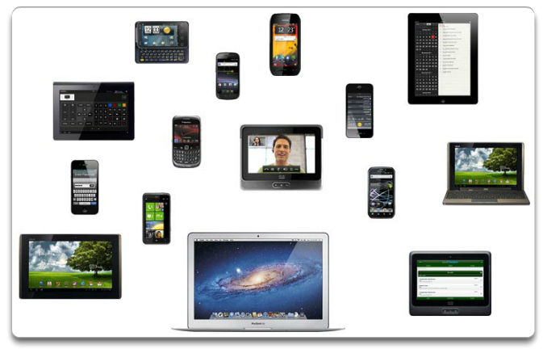
Endpoint Security
Common endpoints are laptops, desktops, servers, smartphones, and tablets.
Securing endpoint devices is challenging.
Employees need to be trained on proper use of the network.
Policies often include the use of antivirus software and host intrusion prevention.
More comprehensive endpoint security solutions rely on network access control.

Slide 25
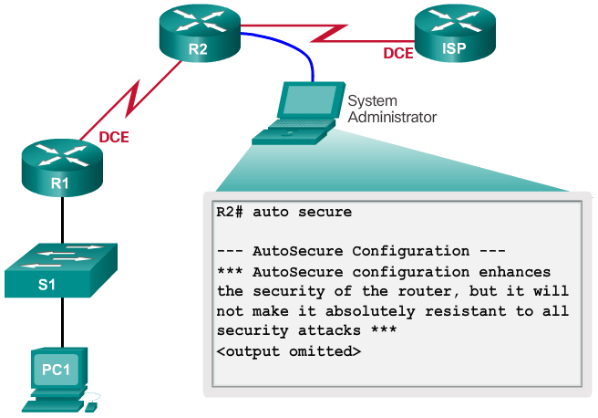
Device Security Overview
Default settings are dangerous because they are well-known.
Cisco routers have the Cisco AutoSecure feature.
In addition, the following apply for most systems:
Change default usernames and passwords immediately
Restrict access to system resources to authorized individuals only.
Turn off unnecessary services.
Update any software and install any security patches prior to production operation.

Slide 26
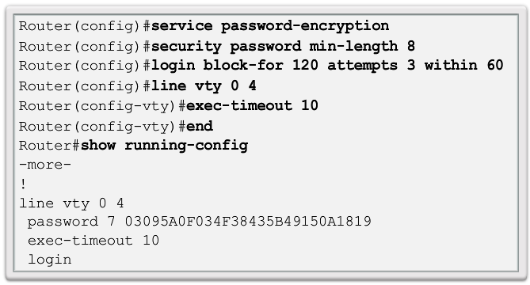
Basic Security Practices
Strong passwords are only as useful as they are secret.
The service password-encryption command encrypts the passwords in the configuration.
The security passwords min-length command ensures all configured passwords have a minimum specified length.
Blocking several consecutive login attempts helps minimize password brute-force attacks.
login block-for 120 attempts 3 within 60 will block login attempts for 120 seconds if there are three failed login attempts within 60 seconds.
Exec Timeout automatically disconnect idle users on a line

Slide 27
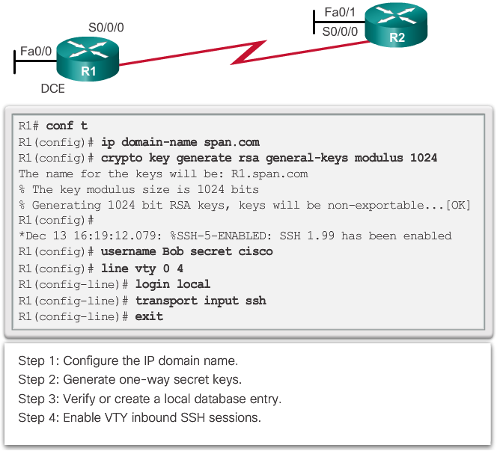
Enable SSH
Telnet is not secure for remote access.
It is highly recommended to use SSH (Secure Shell)
To configure a Cisco device to support SSH takes four steps:
Step 1. Ensure that the router has a unique hostname and an IP domain name.
Step 2. Generate the SSH keys.
Step 3. Create a local username.
Step 4. Enable vty inbound SSH sessions.
The router can now be remotely accessed only by using SSH.

